Slide 1



Call Center_PWC_Solution
View in Power BI
Last data refresh:
8/29/2021 4:16:06 PM UTC
Downloaded at:
1/17/2022 12:12:45 PM UTC

Slide 2
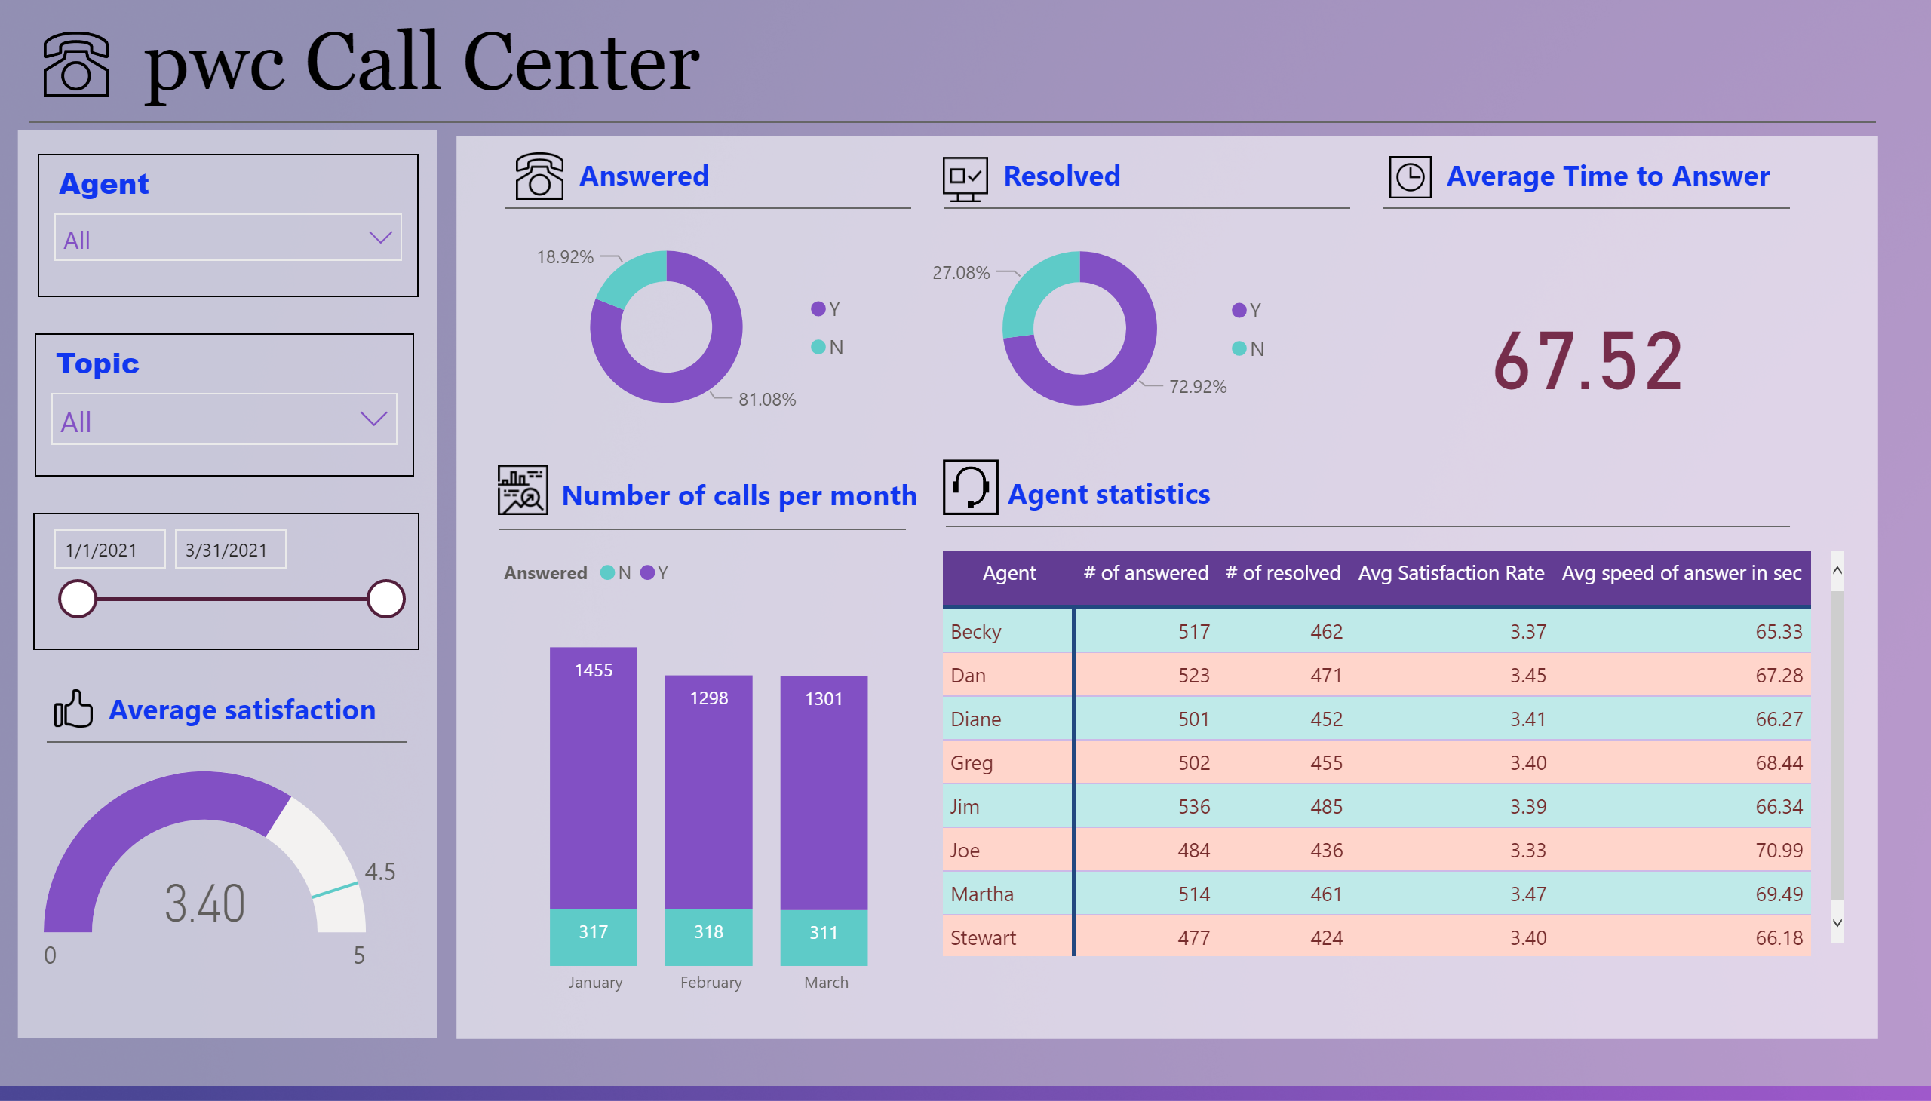
Call Center Manager
Notes:
textbox
No alt text provided
basicShape
No alt text provided
basicShape
No alt text provided
basicShape
No alt text provided
image
No alt text provided
columnChart
No alt text provided
slicer
No alt text provided
pivotTable
No alt text provided
slicer
No alt text provided
slicer
No alt text provided
donutChart
No alt text provided
gauge
No alt text provided
image
No alt text provided
textbox
No alt text provided
basicShape
No alt text provided
donutChart
No alt text provided
textbox
No alt text provided
textbox
No alt text provided
card
No alt text provided
basicShape
No alt text provided
textbox
No alt text provided
basicShape
No alt text provided
basicShape
No alt text provided
image
No alt text provided
image
No alt text provided
image
No alt text provided
textbox
No alt text provided
basicShape
No alt text provided
textbox
No alt text provided
basicShape
No alt text provided
image
No alt text provided
image
No alt text provided

